Slide 1
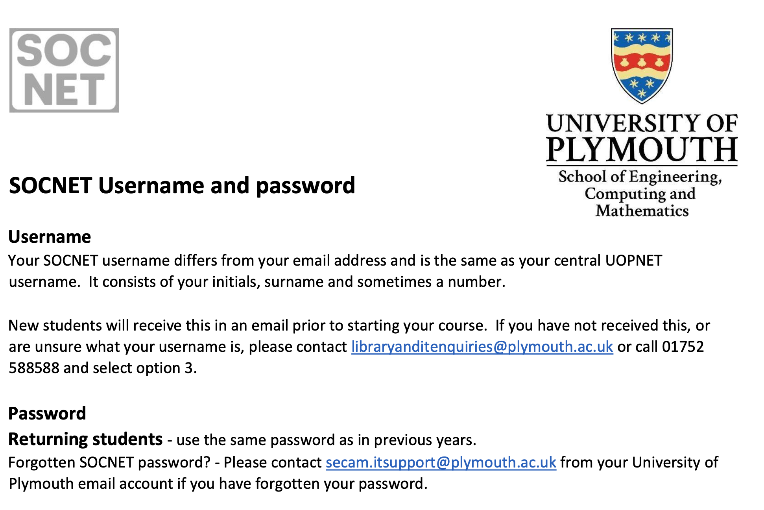
Notes:
Register before we get started

Slide 2

TEAM ENTERPRISE
CY-ZH-KV
Notes:
Register before we get started

Slide 3
Lock Eyes. . .
Notes:
Lock eyes……
Thanks for turning up

Slide 4
TEAM ENTERPRISE
OVERVIEW + INTRODUCTION TO THE MODULE
NTERPRISE
Notes:
Thanks for turning up
Introduction to the module
Overview of the two modules
Hopefully Get to know each other

Slide 5
TYLER CHENG
tyler.cheng@plymouth.ac.uk
NTERPRISE
Notes:
Whoami
Have I met any of you before?
I’m really excited to be delivering
Apologise
More ready….

Slide 6
TEAM ENTERPRISE
OVERVIEW + INTRODUCTION TO THE MODULE
NTERPRISE
Notes:
What are we going to be doing over the next few months
Form teams and launch a startup
Aim to bring a product to market
Generating assets for a business along the way
??? Y Combinator / startup incubator
Based on that short description. . .
Anyone looking forward to doing that?
Anyone wanted to start a company?

Slide 7
TEAM ENTERPRISE
OVERVIEW + INTRODUCTION TO THE MODULE
NTERPRISE
Notes:
Hopefully enjoyable
Because we follow the startup path
Module that might
Move faster than you’re comfortable with initially (move fast, break things)
Push you out of your comfort zone
Expose you to critique that makes you feel uncomfortable
These are all part of startup life
All part of the workplace
>> If you struggle with that

Slide 8
TEAM ENTERPRISE
OVERVIEW + INTRODUCTION TO THE MODULE
NTERPRISE
Notes:
Or anything else
Talk to the team.
Talk to me.
My job to help you to succeed and do well
Helping you overcome these challenges are a part of it
Lot of contact time in these sessions,
Find out how best to contact me later

Slide 9
REMEMBER THAT PERSON
Notes:
Remember that person
Think about a game you’re playing,
why it hooks you in
>> What will we be doing

Slide 10



Team Enterprise Overview
Notes:
Guess from the name. . . You’ll be in a team
Once you’re in teams, you’ll
Analyze the market to try and spot a gap or problem to solve
Create a product to fill that gap

Slide 11

Team Enterprise Overview
Notes:
>> By doing that you’ll generate
Awesome portfolio piece
Game or tool
Talk if you want to make something else

Slide 12



Team Enterprise Overview
Notes:
A launch website
?? Anyone built a website ??
Documentation to support the development of the game
?? Anyone written a GDD spec doc ??
Testing and raw data
?? Has testing improved something you’ve made ??

Slide 13
Team Enterprise Overview

Slide 14
Team Enterprise Overview
Group up and form a * startup company *

Slide 15
Team Enterprise Overview
Group up and form a * startup company *
Understand where your product fits within a value chain
Notes:
The steps that go into turning an idea into a product in the users hands

Slide 16
Team Enterprise Overview
Group up and form a * startup company *
Understand where your product fits within a value chain
Assign roles and take responsibility for the technical development, project management and user experience

Slide 17
Team Enterprise Overview
Group up and form a * startup company *
Understand where your product fits within a value chain
Assign roles and take responsibility for the technical development, project management and user experience
Develop your minimum viable product

Slide 18
Team Enterprise Overview
Group up and form a * startup company *
Understand where your product fits within a value chain
Assign roles and take responsibility for the technical development, project management and user experience
Develop your minimum viable product
You will show evidence of:
Launch website
Project documentation
Company Standard Operating Procedures
Efficacy of product against project goals

Slide 19
QUESTIONS?

Slide 20
Team Enterprise Connection Over Modules
COMP3013
TEAM ENTERPRISE
Start up company
Define a project within the context of industry
Make a prototype
COMP3014
INDUSTRY ENGAGEMENT
Engage with target audience to inform your projects
Launch projects to industry
Make your mark before you graduate
Notes:
Thing you learn feed into COMP 3014
Apply these learnings to the real world
You may even choose to continue this project in someway
This module = foundation
Next module = Release to market
Don’t have to do that tho
Anyone have idea for their industry engagement?

Slide 21
STRUCTURE
Notes:
1 lecture
1 workshop
Formative feedback
20 credit with lots of independent
Hit the ground running

Slide 22
Team Enterprise Schedule
Click Me
Notes:
All dates are provisional

Slide 23

Team Enterprise Teans
Notes:
Anyone used teams before?
Communication tool used in business
Used by the last company I worked for (90 people)
Industry standard
?? Anyone know any alernatives

Slide 24
Team Enterprise Teans
qmgsu6i
Notes:
Teams will be the default communication platform
You get to choose others
Important announcements
Remote classes
Video calls
Let’s get you setup on your machine

Slide 25

Value Chain Overview
Notes:
- Set of steps within a business
- Each item adds another layer of value

Slide 26
Value Chain Overview
A value chain is a series of consecutive steps that go into the creation of a finished product, from its initial design to its arrival in a customer’s hand.
Notes:
identifies each step in the process at which value is added,
including
sourcing,
manufacturing, and
Marketing
Each item adds another layer of value
>> Purposes of this module

Slide 27
Value Chain Overview
 | WHITE SPACE ANALYSIS | IDEATION | INCUBATION | READY FOR LAUNCH
 | Identify customer / market needs Evaluate existing tech that solve customer / market needs Develop preliminary ideas and concepts | SWOT analysis presented ideas Benchmark ideas to target market | Create a team with the right skillset Develop prototypes Decide what to keep and what to throw away | Develop specifications, marketing, and product launch
Notes:
- Break it down into 4 steps

Slide 28
Value Chain Overview
 | WHITE SPACE ANALYSIS | IDEATION | INCUBATION | READY FOR LAUNCH
 | Identify customer needs Evaluate existing tech that solve customer needs Develop preliminary ideas and concepts | SWOT analysis presented ideas Benchmark ideas to target market Build proof of concept * | Create a team with the right skillset Develop prototypes Decide what to keep and what to throw away | Develop specifications, marketing, and product launch
Notes:
- Define Value chain
- Each item adds another layer of value
- *prototype – super basic

Slide 29
Value Chain Overview
 | WHITE SPACE ANALYSIS | IDEATION | INCUBATION | READY FOR LAUNCH
 | Identify customer needs Evaluate existing tech that solve customer needs Develop preliminary ideas and concepts | SWOT analysis presented ideas Benchmark ideas to target market Build proof of concept | Create a team with the right skillset Develop prototypes Decide what to keep and what to throw away | Develop specifications, marketing, and product launch
Notes:
- Define Value chain
- Each item adds another layer of value

Slide 30
Value Chain Overview
 | WHITE SPACE ANALYSIS | IDEATION | INCUBATION | READY FOR LAUNCH
 | Identify customer needs Evaluate existing tech that solve customer needs Develop preliminary ideas and concepts | SWOT analysis presented ideas Benchmark ideas to target market Build proof of concept | Create a team with the right skillset Develop prototypes Decide what to keep and what to throw away | Develop specifications Build a Minimum Viable Product (MVP) Market the team and product
Notes:
- Define Value chain
- Each item adds another layer of value

Slide 31
Value Chain Overview
 | WHITE SPACE ANALYSIS | IDEATION | INCUBATION | READY FOR LAUNCH
 | Identify customer needs Evaluate existing tech that solve customer needs Develop preliminary ideas and concepts | SWOT analysis presented ideas Benchmark ideas to target market Build proof of concept | Create a team with the right skillset Develop prototypes Decide what to keep and what to throw away | Develop specifications Build a Minimum Viable Product (MVP) Market the team and product
Notes:
You might not do every one, but…
Could look at other peoples value chain
Make something to speed them up
Developer tool (Artists, developers, business) XYZ
App
Assumes games, but not limited to it

Slide 32
QUESTIONS?

Slide 33
 | PROJECT MANAGER | TECHNICAL DIRECTOR | USER EXPERIENCE GURU
 | SOFTWARE DEVELOPER
TEAM ROLES
Notes:
In your teams
Aim to take fill these roles
Manage your resources appropriately
3 people +-

Slide 34
 | PROJECT MANAGER | TECHNICAL DIRECTOR | USER EXPERIENCE GURU
 | In charge of strategy for project development Establish agile approach for team to follow Establish feature releases schedule Document meetings/reviews Review project development for improvement
 | SOFTWARE DEVELOPER
TEAM ROLES
Notes:
- thinking about all these things in your retrospective at the end of each sprint

Slide 35
 | PROJECT MANAGER | TECHNICAL DIRECTOR | USER EXPERIENCE GURU
 | In charge of strategy for project development Establish agile approach for team to follow Establish feature releases schedule Document meetings/reviews Review project development for improvement | Define technical strategy, tools and processes Establish and enforce rules of engagement for version control and repo Communicate/document development approach Review technical strategy for improvement
 | SOFTWARE DEVELOPER
TEAM ROLES
Notes:
- retrospective at the end of each sprint

Slide 36
 | PROJECT MANAGER | TECHNICAL DIRECTOR | USER EXPERIENCE GURU
 | In charge of strategy for project development Establish agile approach for team to follow Establish feature releases schedule Document meetings/reviews Review project development for improvement | Define technical strategy, tools and processes Establish and enforce rules of engagement for version control and repo Communicate/document development approach Review technical strategy for improvement | Develop blueprints for experience design Create a testing plan that integrates with feature release schedule Establish rules of engagement for developer facing testing Analyse and disseminate results of testing Review testing practices for improvement
 | SOFTWARE DEVELOPER
TEAM ROLES
Notes:
- Testing time built into the session
- thinking about all these things in your retrospective at the end of each sprint

Slide 37
 | PROJECT MANAGER | TECHNICAL DIRECTOR | USER EXPERIENCE GURU
 | In charge of strategy for project development Establish agile approach for team to follow Establish feature releases schedule Document meetings/reviews Review project development for improvement | Define technical strategy, tools and processes Establish and enforce rules of engagement for version control and repo Communicate/document development approach Review technical strategy for improvement | Develop blueprints for experience design Create a testing plan that integrates with feature release schedule Establish rules of engagement for developer facing testing Analyse and disseminate results of testing Review testing practices for improvement
 | SOFTWARE DEVELOPER
 | All group members will take responsibility for the development of project
TEAM ROLES
Notes:
- thinking about all these things in your retrospective at the end of each sprint

Slide 38
QUESTIONS?

Slide 39
QUESTION
Notes:
I’m gonna throw some qestions to the room
Hands up if you’ve heard of these terms

Slide 40
Agile
Notes:
I’m gonna throw some qestions to the room
Hands up if you’ve heard of these terms

Slide 41
Sprint
Notes:
I’m gonna throw some qestions to the room
Hands up if you’ve heard of these terms

Slide 42
Iteration
Notes:
I’m gonna throw some qestions to the room
Hands up if you’ve heard of these terms

Slide 43
DESIGN PROCESS
HIGH LEVEL OVERVIEW
DEFINE
DESIGN
EVALUATE
ITERATE

Slide 44
DESIGN PROCESS
HIGH LEVEL OVERVIEW
DEFINE
Understand the details of the problem to define what must be designed. Gather consensus for direction between developer and client
DESIGN
EVALUATE
ITERATE

Slide 45
DESIGN PROCESS
HIGH LEVEL OVERVIEW
DEFINE
Understand the details of the problem to define what must be designed. Gather consensus for direction between developer and client
DESIGN
Research the mechanics and assets required to meet specification. Create conceptual output that synthesises the details, themes and interconnection of developed elements
EVALUATE
ITERATE

Slide 46
DESIGN PROCESS
HIGH LEVEL OVERVIEW
DEFINE
Understand the details of the problem to define what must be designed. Gather consensus for direction between developer and client
DESIGN
Research the mechanics and assets required to meet specification. Create conceptual output that synthesises the details, themes and interconnection of developed elements
EVALUATE
Justify that developed elements are fit for purpose and inform required changes for future feature releases
ITERATE

Slide 47
DESIGN PROCESS
HIGH LEVEL OVERVIEW
DEFINE
Understand the details of the problem to define what must be designed. Gather consensus for direction between developer and client
DESIGN
Research the mechanics and assets required to meet specification. Create conceptual output that synthesises the details, themes and interconnection of developed elements
EVALUATE
Justify that developed elements are fit for purpose and inform required changes for future feature releases
ITERATE
Development is rarely successful on the first attempt. Take what you have, and repeat the design process to evaluate how the current implementation fits projects needs and where it falls short

Slide 48
MODULE SOP
Notes:
Standard Operating procedures
Rules of engagement for a team, company module
The promises we make as a group of people
This module has a few

Slide 49
MODULE SOP
Async Communication
Notes:
Async communication
Your fault if you get a notification ☺

Slide 50
MODULE SOP
Open & Honest
Notes:
Teams work best with open and honest communication
Feedback
It’s not always easy to give or receive
Great opportunity to learn and improve
I’m here to facilitate it

Slide 51
MODULE SOP
Move Fast & Fix Things
Notes:
Anyone heard the saying?
Done is better than perfect.

Slide 52
MODULE SOP
Teams over
Email
Notes:
Teams will be the default communication platform
You get to choose others
Important announcements
Remote classes
Video calls

Slide 53
MODULE SOP
Non zero-sum
Notes:
Usual university rules apply / plagerism etc etc
Share knowledge amongst the group
Environment dictates performance
Helping others improve
Get’s you better feedback

Slide 54
MODULE SOP
AI Friendly
Notes:
We’re building prototypes
Tools can speed us up
REPORT NEEDS TO BE YOUR OWN WORK
EVERYTHING WITHIN UNI GUIDELINES

Slide 55
MODULE SOP
Give it a go
Notes:
Give things a go

Slide 56
MODULE SOP
Accepting & understanding
Notes:
Give things a go

Slide 57
MODULE SOP
I’m on your side
Notes:
Give things a go

Slide 58
Team Enterprise Assignments
Click Me
01
Notes:
All dates are provisional. Completely ignore them for now.
Proper copy will be shared
KEEP ASKING QUESTIONS

Slide 59
Team Enterprise DLE
Click Me
01

